Slide 1


A World-Wide Picture of Cardiac Rehabilitation Services
Sherry L. Grace, PhD, FCCS
Full Professor, York University
Sr. Scientist & Dir. CR Research, University Health Network
Chair, International Council of Cardiovascular Prevention and Rehabilitation
Toronto, Canada

Slide 2
Outline
Availability / need
Nature of services offered where available

Slide 3













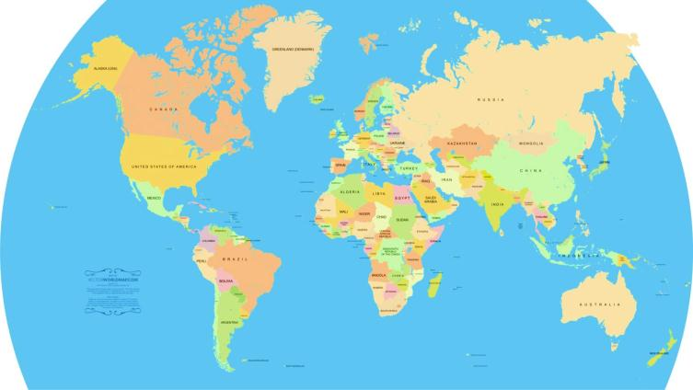





















34 Associations of the
Notes:
We now have representation from approximately 80% of countries with CR on our Council globally

Slide 4
Friends of
Dr Meliani Abdelhafid (Morocco)
Dr Stefan Farsky (Slovak Republic)
Dr Ahmad Salman
(Kuwait)
Dr Karam Adawi
(Qatar)
Dr Sumana Baidya (Nepal)
Dr Ssu-Yaun Chen (Taiwan)
Dr Basuni Radi (Indonesia)
Jacqueline Hol (Curacao)
Dr Rufus Adedoyin (Nigeria)
Dr Boukhis Marouen
(Tunisia)
Dr Jong Seng Khiong
(Brunei Darussalam)
Notes:
Countries without CR, cardiac or PMR societies

Slide 5



Procedure: Global Survey CR
National CR/ Cardiology Society
International Assoc. & Google
Champion in the field
Literature Review- countries w CR
List of countries
(N=203)
Global Heart
KTA& SLG; NR:C
To reach
CR programs

Slide 6

Characterizing CR Density/Need
(1) national capacity: median number of pts a program could serve annually among the responding programs in a given country, multiplied by the total number of programs in the country with CR
(2) national density: national capacity (#1; # spots) per annual incident IHD case in a country (from Global Burden of Disease study; doesn’t consider HF etc)
(3) unmet need: IHD incidence (GBD) minus national capacity (#2)
Turk-Adawi…Grace; 2019; EClinMed
Notes:
How many more spots do we need per year

Slide 7
Sample
CR programs that offered services to patients following discharge for an acute cardiac event (i.e. Phase II) globally
Inclusion criteria:
  Offers initial assessment,
  Structured exercise &
  ≥1 other strategy to control risk factors

Slide 8
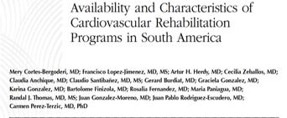
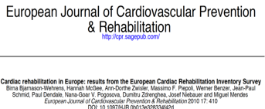
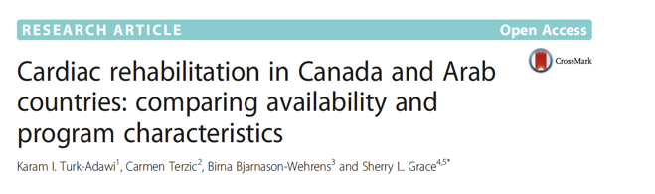
Measures
JCRP 2013
BMC HSR 2015
Notes:
Development of the survey is described in detail elsewhere.(Turk-Adawi, Terzic et al. 2015) It was pilot-tested in the Arab world and Canada. The final survey (see online supplement in X ) was translated to Portuguese, Spanish and Mandarin character. The translations were reviewed and approved by a national champion with the corresponding first language. The survey assessed program capacity, wait times, proximity to other CR programs, and barriers to serving more patients, among other items.

Slide 9

Results: Availability of CR (111/203, 54.7%), by IHD Incidence
IHD incidence source: GBD
Turk-Adawi…Grace; 2019; EClinMed
Notes:
Worldwide, CR exists in 56 (86·2%) of the 65 high-income countries (HICs), 49 (47·1%) of the 104 middle-income countries (MICs), and in 6 (20·0%) of the 30 low-income countries (LICs).
As shown in Table 1, the first CR program opened in 1944 in Mexico. Soon after, programs opened in Eastern Europe (Germany [1950], Croatia [1957], and Bulgaria [1958]). In 58 (52·3%) countries, the first CR program opened since 2000.
# countries with CR in each WHO region:
Africa: 4/47 (8.5%)
Americas: 22/39 (56.4%)
Eastern Mediterranean: 9/21 (42.9%)
Europe: 41/56 (73.2%)
South East Asia: 6/11 (54.5%)
Western Pacific: 10/28 (35.7%)

Slide 10
Availability by WHO Region
 | % of countries w CR
Africa | 17.0
Americas | 70.0
Eastern Mediterranean | 54.5
Europe | 80.7
South-East Asia | 54.5
Western Pacific | 42.7
Global | 54.7

Slide 11
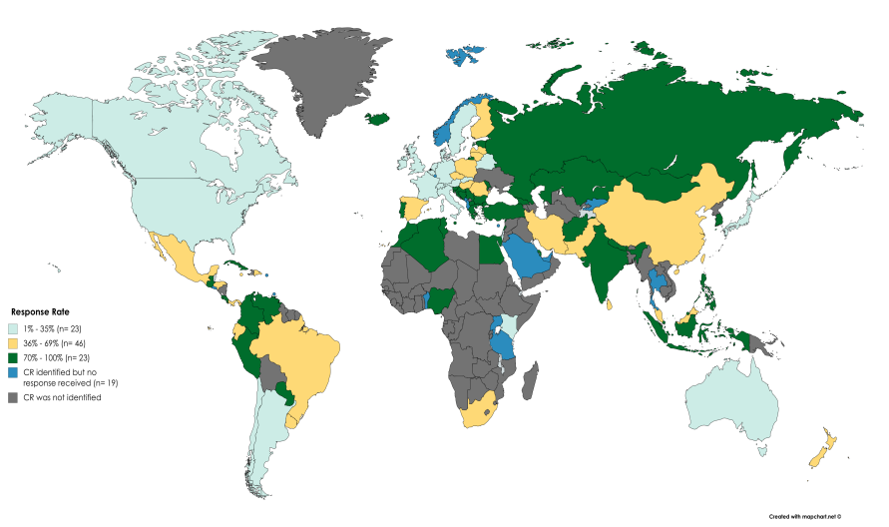
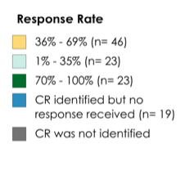
Survey Results: Response Rate
Data were collected in 93/111 (83.8%) countries w CR
N=1082 surveys, 32.1% response rate
Mean 9.7
± 17.3 surveys / country

Slide 12
Median Program Volumes
WHO Region
Africa | 50
Americas | 80
Eastern Mediterranean | 120
Europe | 300
South-East Asia | 160
Western Pacific | 200
Global | 157

Slide 13
Some Volume Drivers
Non-clinical settings
OR=1.05 (1.04-1.06)
Private funding
OR=0.92 (0.91-0.93)
3. Systematic Referral
Notes:
Individual programs could serve more patients where they offered alternative models, and were not privately-funded; volume of patients per session may also play a role. The fact that programs served fewer patients where there were proximate programs and wait times were longer are likely a reflection of reverse causality; where there is more capacity in a region a program does not have to serve the same volume of patients, and where there is capacity patients do not have to wait as long to start the program. However, the former factors point to important areas for advocacy. We must advocate for public funding policies for CR, and we must support CR programs to deliver services outside major clinical centers so we can reach the vast number of patients in need. Some guidance on CR delivery in alternative settings in low-resource countries is available.²⁴ Indeed in the Americas, Europe and the Western-Pacific where availability and capacity are greatest, there was more often public or hybrid funding and more programs offered alternative models than the other regions (data not shown). Research is needed to understand how countries with the greatest capacity have achieved their heights, including the role of session volume (while maintaining safety), so that it can be replicated elsewhere.

Slide 14
Median Regional Density
WHO Region | 1 spot per n patients
Africa | 474
Americas | 23
Eastern Mediterranean | 213
Europe | 9
South-East Asia | 179
Western Pacific | 7
Global | 21
NOTE: this does not include heart failure, among other patient groups indicated for CR
Notes:
*this considers countries without CR now
For HICs, the median national CR density was 5, for MICs was 53, and for LICs was 308. As also shown in Table 1, density was poorest in Africa, and best in the Europe.
CR density was ranked by country (Table 1). After Bermuda, Scotland and Lithuania had the best density. The top 25 countries were all HICs, except the following three MICs: Georgia (8th), Argentina (17th) and Colombia (22nd).

Slide 15
IHD Incidence in Countries w/out CR, N=92
Country | WHO region | Income classification | IHD incidence
Ukraine | Europe | LMI | 519,761
Vietnam | Western Pacific | LMI | 238,156
Ethiopia | Africa | LIC | 138,477
Iraq | Eastern Mediterranean | UMI | 117,130
Sudan | Eastern Mediterranean | LMI | 111,063
Myanmar | South-East Asia | LMI | 108,283
Source: GBD
Notes:
All rest <100,000
BUT UNMET NEED HIGHER IN SOME COUNTRIES THAT HAVE SOME CR

Slide 16
Greatest Unmet Need in LMICs (w or w/out CR)
Country | # IHD pt spots needed / yr
India | 3,304,474
China | 3,034,003
Russia | 1,222,142
Pakistan | 616,146
Brazil | 523,662
Ukraine* | 519,761
All LMICs | 14,766,930
*country has no CR

Slide 17
Summary
5,753 programs globally
can serve 1,655,083 patients/year,
  despite an estimated 20,279,651 incident IHD cases globally/year
Global CR need = 18,624,568 spots/year
  Most need in LMICs
GBD

Slide 18
2. Nature of Services

Slide 19
CR Staff Composition
5.9±2.8/ program
n=18
n=261
n=24
n=484
n=43
n=251
n=1082
680 (69.1%) programs headed by some type of MD
n=272
n=705
n=33
Supervia…. Grace (2019); EClinMed

Slide 20
Accepted Diagnoses
n=18
n=261
n=24
n=484
n=43
n=251
n=1082
Notes:
NO SIG
Say variation around revasc is likely due to less procedures done in African as LICs
RHD more common where it is more burdensome
Non-cardiac – Afr skewed as so few programs, but mostly for NCDs
Primary prevention 60%; PVD 50%; DM 50%; lung disease 40%; stroke 30%

Slide 21
Median CR Dose
Median sessions/wk= 2.5
Median number wks= 11
Median mins/session= 59
†
ǂ ǂ ǂ
‖‖‖
**
†
ǂ ǂ ǂ
‖‖‖
For pairwise comparisons *ǂ†◊‖: one symbol=p<.05; two symbols=p<.01; 3 symbols=p<.001
Notes:
2.5 x 11 = 27.5 (so 25-30 sessions on average around the globe)

Slide 22
Core Components Delivered
8.7±1.9
/11
n=18
n=261
n=24
n=484
n=43
n=251
n=1082
***
ǂǂ
ǂǂ
***
*= p< 0.05; **= p< 0.01; *** = p< 0.001
Notes:
Top box stars means diff by WHO region
Overall, delivery of the core components was high, but the quality of what was delivered in each component was not assessed. However, some important elements of secondary prevention recommendations for CVD⁵ were not commonly offered in CR, likely due to limited resources. Elements which are particularly important in low-resource settings were also unfortunately infrequently offered, namely smoking cessation services and counselling for return-to-work.

Slide 23
Risk Factors Assessed
n=18
n=261
n=24
n=484
n=43
n=251
n=1082
%
Notes:
High quality

Slide 24
Median Cost to Deliver to 1 Patient
WHO Region | $USD 2016 PPP
Africa | 1598.30
Americas | 731.48
Eastern Mediterranean | 803.90
Europe | 1554.35
South-East Asia | 284.79
Western Pacific | 526.04
Global | 945.90

Slide 25
Who Pays for CR by WHO Region
n=18
n=261
n=24
n=484
n=43
n=251
n=1082
60% of countries patients pay
mean=$626USD PPP/program
n=592
n=268
n=202
Moghei … Grace; IJC 2019; v276
Notes:
In 67/93 (72.0%) countries, patients pay some
average cost to patients globally: $591.59 ± $1,043.70 (2016 PPP)

Slide 26
Non-Clinical Delivery Settings
n=18
n=261
n=24
n=484
n=43
n=251
n=1082
HIC
35.4%
Ghisi… Grace; J Clin Med 2018; v7(9)
Notes:
No significance
EXPLOIT ICT GIVEN MOBILE PENETRANCE IN LMICs

Slide 27

Limitations
Density estimates
Generalizability:
  Low program response rate
  Ascertainment and selection bias
    Higher quality programs responding?
Self-report measures (not validated against delivery)
  Socially-desirable responding, therefore findings may reflect higher quality than reality
Delivery costs: rough estimates
Notes:
Respondents may be inclined to respond in a Socially-desirable responding manner, such that results are skewed to reflect better provision of CR in that program or country

Slide 28
Discussion
Despite overwhelming evidence of the clinical and economic benefit of CR, only half of countries have it available.
  Of these 1/3 have only 1; and ½ have ≤5 programs
  # spots needed globally - LMICs
SCALE UP: alternative settings (exploit IT, community spaces & primary care)
Public funding?
Health human resources – providers to refer and to deliver CR
Notes:
We thought 38.8% countries had it in NR:C paper, but that was literature review, not contacting countries directly. Now 55%

Slide 29
Discussion
2. Where available, the nature of services delivered is generally of high quality, but there is significant regional variation
  e.g., accepted indications consistent w guidelines
  # staff consistent (~6), but composition varies
    Most led by MD
  Core components: ~9/11
    need more smoking cessation, psychosocial and R2W
  Dose (~22 sessions): varies
Notes:
In this first ever survey of the nature of CR delivery around the globe, the overall high quality of CR in the half of countries where it is available was established. However, deficits were identified, as were significant global variations. Most programs appropriately accepted patients following acute coronary syndrome and revascularization, but fewer accepted those with heart failure, and stable coronary artery disease. Programs consistently had five staff members, with most commonly a cardiologist as medical director, with nurses, exercise specialists, physiotherapists, and administrative assistants on staff. Programs on average offered seven of the ten recommended core components, typically initial assessment, patient education, exercise training, and management of risk factors (except tobacco use); nutrition counselling and stress management were not as consistently offered.

Slide 30


Acknowledgements, etc.
Co-Investigators: Marta Supervia, Karam Turk-Adawi, and Francisco Jimenez Lopez
Funding: Faculty of Health, York University
Protocol Endorsement:
Contact Information: sgrace@yorku.ca
ICCPR Resources: http://globalcardiacrehab.com/

Slide 31
Other Champions
Supervia, M., Turk-Adawi, K., Lopez Jimenez, F., Pesah, E., Rongjing, D., Britto, R., Bjarnason-Wehrens, B., Derman, W., Abreu, A., Babu, A., Anchique Santos, C., Khiong, J.S., Cuenza, L., Yeo, T.J., Scantlebury, D., Andersen, K., Gonzalez, G., Giga, V., Vulic, D., Vataman, E., Cliff, J., Kouidi, E., Yagci, I., Kim, C., Benaim, B., Rivas-Estany, E., Fernandez, R., Radi, B., Gaita, D., Simon, A., Chen, S.Y., Roxburgh, B. Castillo Martin, J., Maskhulia, L., Burdiat, G., Salmon, R., Lomelí, R., Sadeghi, M., Sovova, E., Hautala, A., Prasciene, E., Ambrosetti, M., Neubeck, L., Asher, E., Kemps, H., Eysymontt, Z., Farsky, S., Hayward, J., Prescott, E., Dawkes, S., Santibanez, C., Zeballos, C., Pavy, B., Kiessling, A., Sarrafzadegan, N., Baer, C., Thomas, R., Hu, D., & Grace, S.L. (2019). Nature of cardiac rehabilitation services around the globe. eClinicalMedicine.
Turk-Adawi, K., Supervia, M.,….., & Grace, S.L. (2019). Cardiac rehabilitation availability and density around the globe. EClinicalMedicine.

